Slide 1


Day-4 (04.07.2024) Deep Dive into Neural Networks and CNNs
Mr. Sheik Jamil Ahmed
Assistant Professor, School of CSE
Presidency University, Bangalore
Karnataka

Slide 2
Topics Covered
Introduction to Neural Network
Perceptrons
Activation Functions
Network Architecture
Overview of Optimization Algorithm
Convolutional Neural Network(CNNs)
Architecture Design and Feature Extraction
Implementation

Slide 3
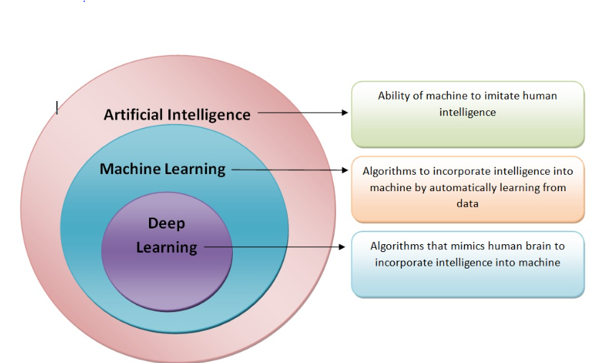
AI vs DL vs ML
https://www.analyticsvidhya.com/blog/2021/06/machine-learning-vs-artificial-intelligence-vs-deep-learning/

Slide 4
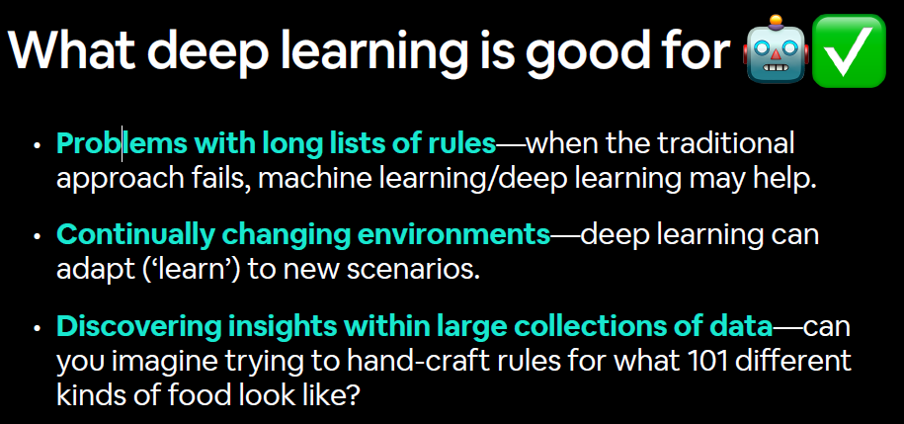

Slide 5
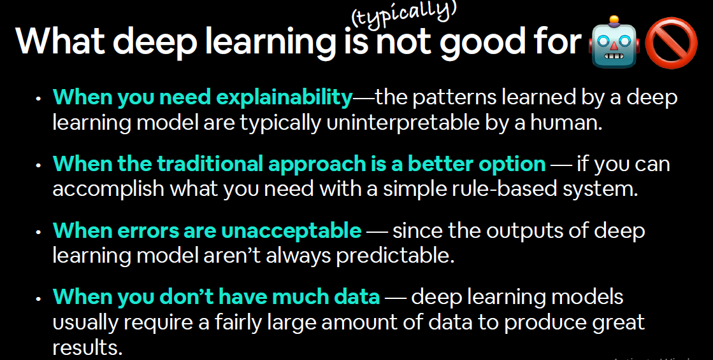

Slide 6
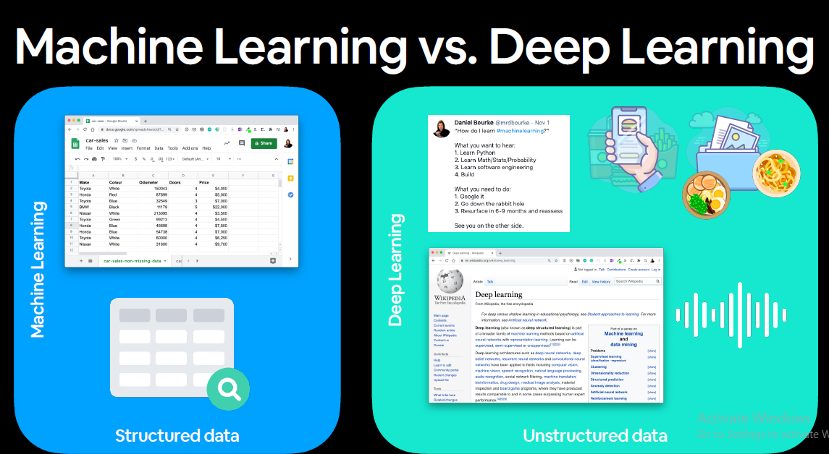

Slide 7
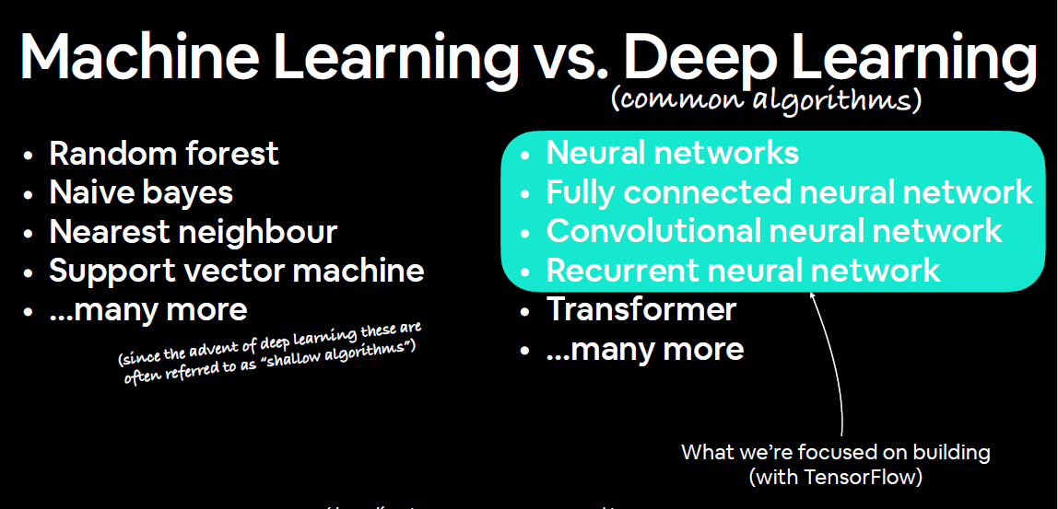

Slide 8
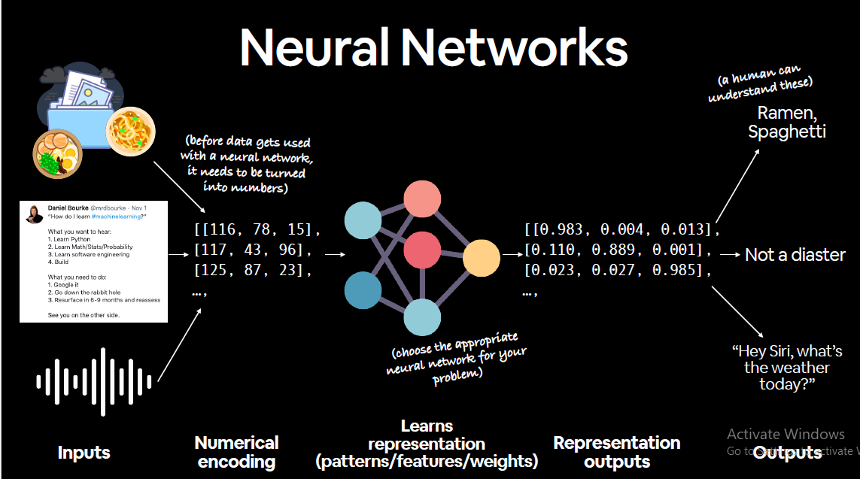

Slide 9
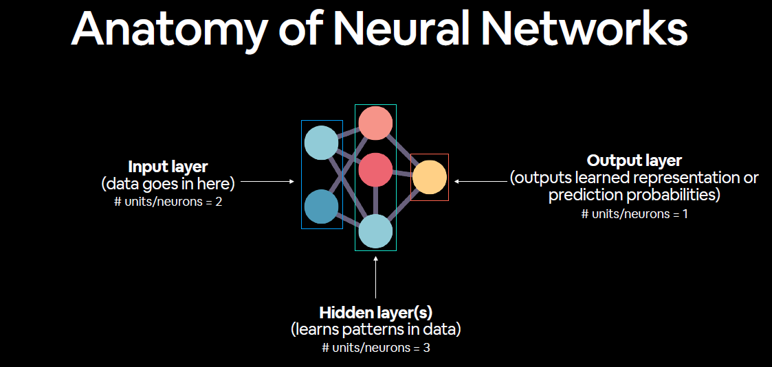

Slide 10
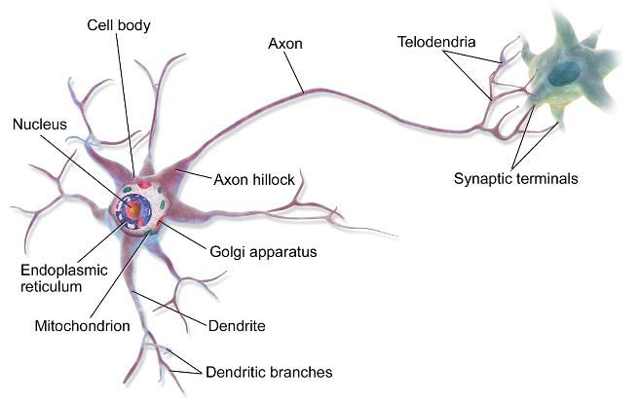
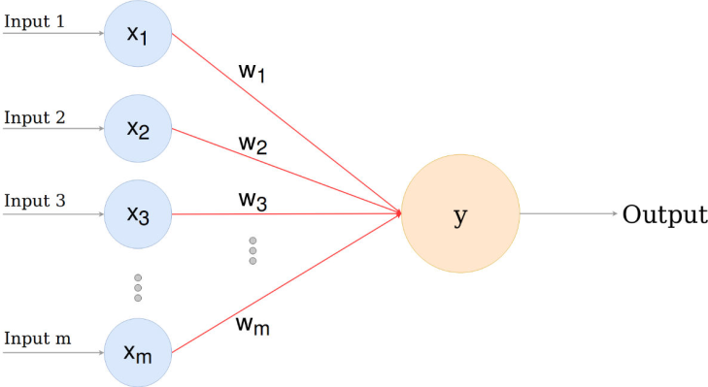
Perceptron
Biological Neuron
Artificial Neuron

Slide 11

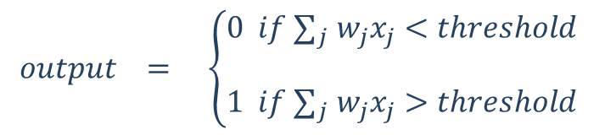
Perceptron

Slide 12
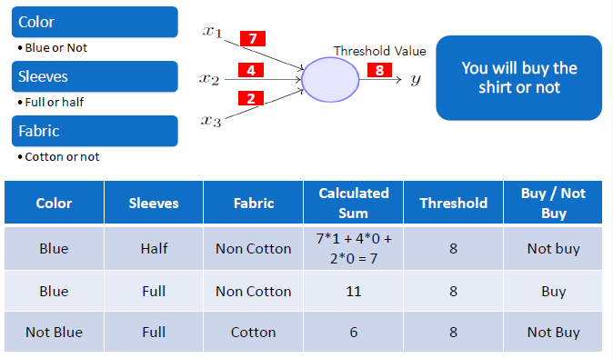
Perceptron-Example

Slide 13

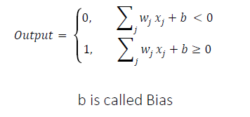
Perceptron-Standard Equation

Slide 14
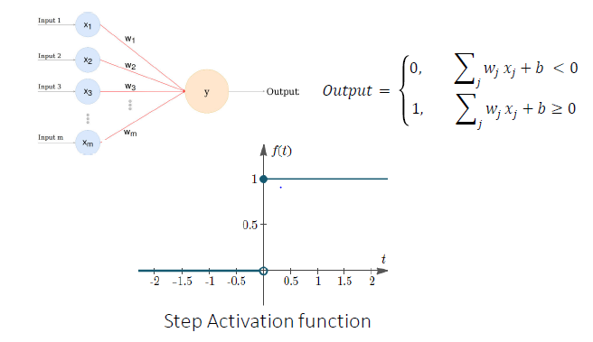
Perceptron-Graphical Representation

Slide 15
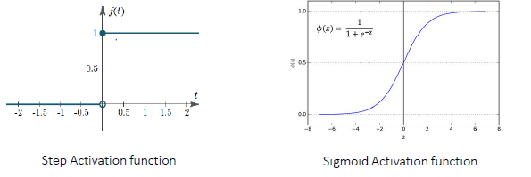
Perceptron-Sigmoid Activation

Slide 16
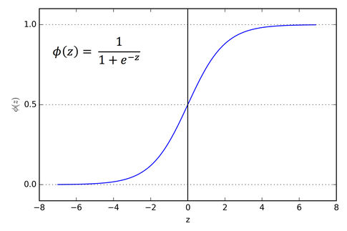
Perceptron-Sigmoid Activation
Sigmoid is better as it is less sensitive to individual observation
Artificial neuron with sigmoid activation is called sigmoid or logistic neuron

Slide 17
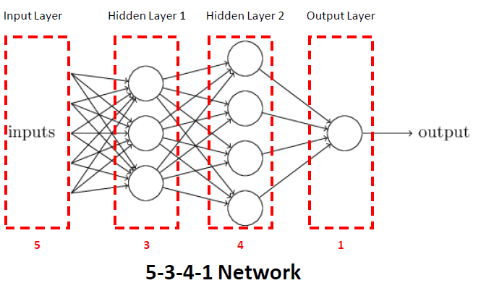
Making Network

Slide 18
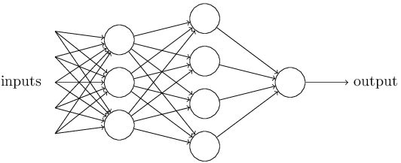
Making Network
Feed Forward Network – One directional processing
Fully connected network – Output from a neuron goes to all neurons of next layer

Slide 19
Deep Learning
More number of layers => Deeper network => More complex relationships

Slide 20
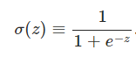
Problem Statement
Problem Statement
• Establish the values of weights and biases so that predicted output is as close to actual output as possible

Slide 21
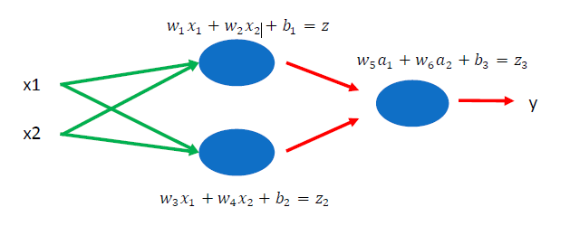
Problem Statement
Variables to be established in this neural network
• Weights - W1, W2……….W6
• Biases - B1, B2, B3
Total - 9 variables

Slide 22
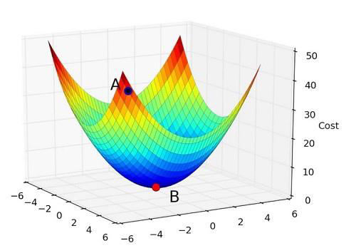
Optimization Technique-Gradient Descent
GD is an optimization technique to find minimum of a function
• Better than other technique such as OLS when we have large number of features and complex relationships

Slide 23
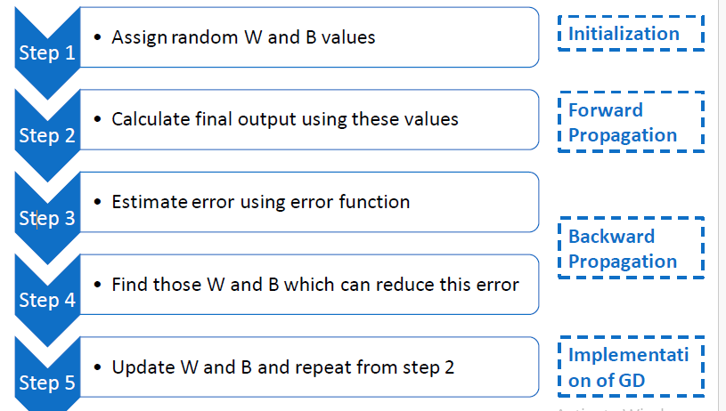
Optimization Technique-Gradient Descent

Slide 24
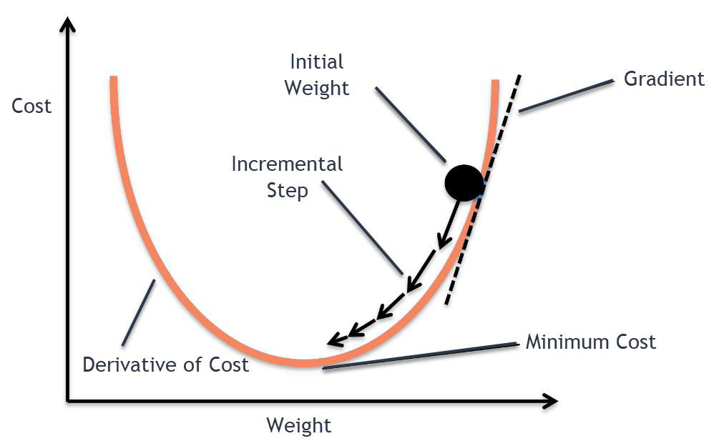
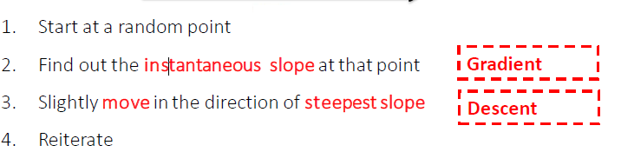
Optimization Technique-Gradient Descent

Slide 25
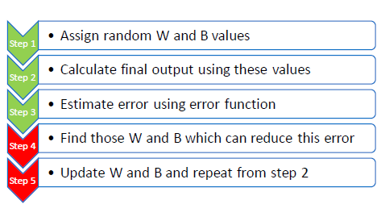
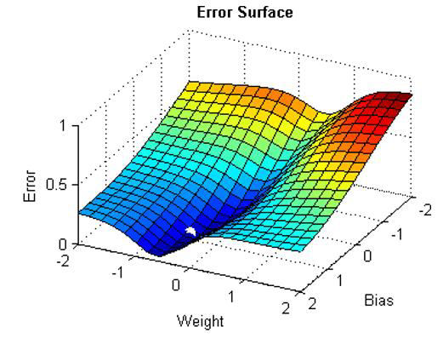
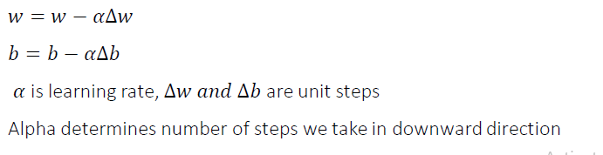
Optimization Technique-Gradient Descent

Slide 26
Optimization Techniques
Q – What is the difference between Gradient descent and stochastic gradient
descent
• Stochastic gradient descent => Single training record, forward and backward
propagation
• Gradient descent => Full training set, forward and backward propagation
• Mini Batch Gradient descent => small batch of training set, forward and
backward propagation

Slide 27
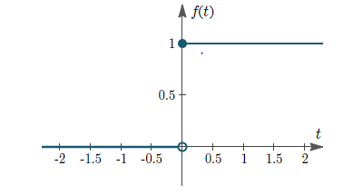
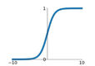
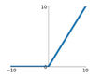
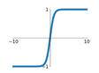
Activation Functions
Step
Sigmoid
Tanh(x)
ReLU(x)=max(0,x)

Slide 28
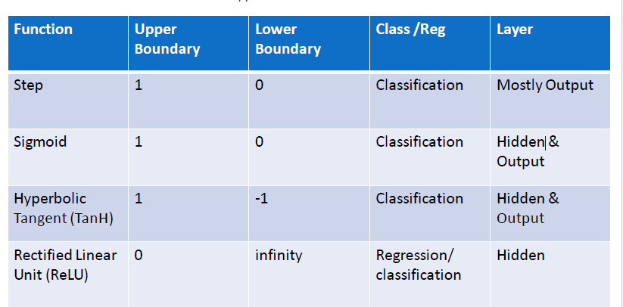
Activation Functions

Slide 29

Activation Functions
Can hidden layer and output layers have different
activation functions?

Slide 30

Activation Functions
Can hidden layer and output layers have different
activation functions?
That we Gonna see in
Code !!!
Code !!!
Code !!!

Slide 31
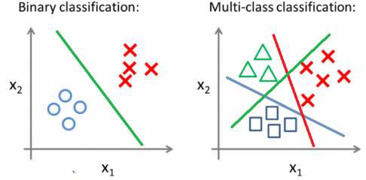
Neural Network
Q. What is multi class classification? Is there any specific activation function
for this?
Two classes like ‘Cat’ or ‘Dog’ => Binary Classification
• More than 2 classes like ‘cat’, ‘dog’ or ‘horse’ => Multiclass classification
• For multiclass, we use softmax activation

Slide 32
Neural Network
“What is an Epoch?”

Slide 33
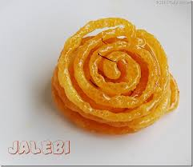
Neural Network
Epoch is one cycle through the full training data
• It is different from iteration
• Example – Suppose we have 1000 training records,
if we are doing SGD i.e. one record is input at a time,
then 1000 iterations within one epoch
• If we enter 1000 records 2 time => Epoch is 2

Slide 34
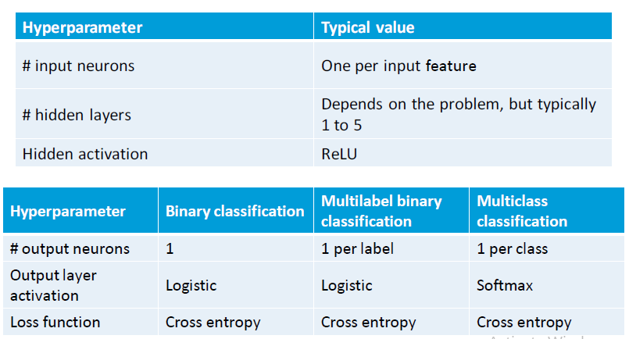
Neural Network

Slide 35
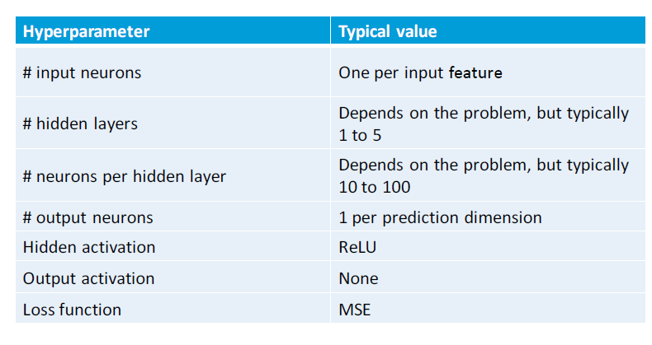
Neural Network

Slide 36
Convolutional Neural Networks (CNNs)

Slide 37

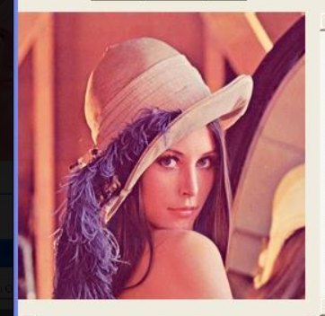
Some Fundamentals of Image Processing
Images are represented as a matrix of pixels.
Gray scale
RGB

Slide 38
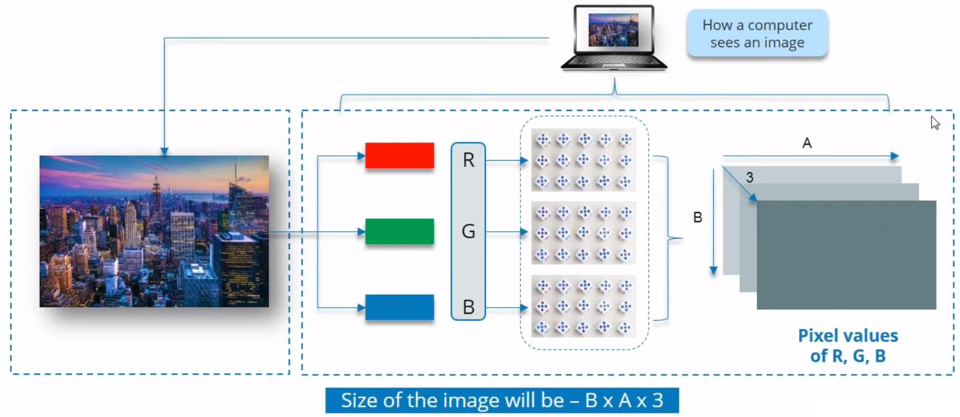
How a Computer sees an Image

Slide 39
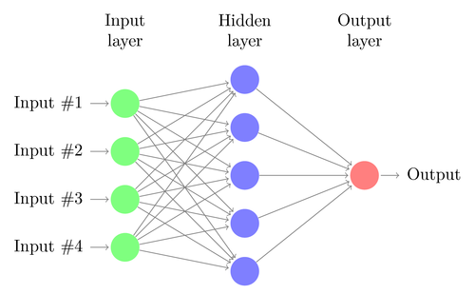
The Problem with Traditional Neural Networks
There are several drawbacks of MLP’s, especially when it comes to image processing.
MLPs use one perceptron for each input (e.g. pixel in an image, multiplied by 3 in RGB case). The amount of weights rapidly becomes unmanageable for large images. For a 224 x 224 pixel image with 3 color channels there are around 150,000 weights that must be trained! As a result, difficulties arise whilst training and overfitting can occur.

Slide 40
The Problem with Traditional Neural Networks
Another common problem is that MLPs react differently to an input (images) and its shifted version — they are not translation invariant.
For example, if a picture of a cat appears in the top left of the image in one picture and the bottom right of another picture, the MLP will try to correct itself and assume that a cat will always appear in this section of the image.

Slide 41
The Problem with Traditional Neural Networks
Clearly, MLPs are not the best idea to use for image processing. One of the main problems is that spatial information is lost when the image is flattened into an MLP

Slide 42
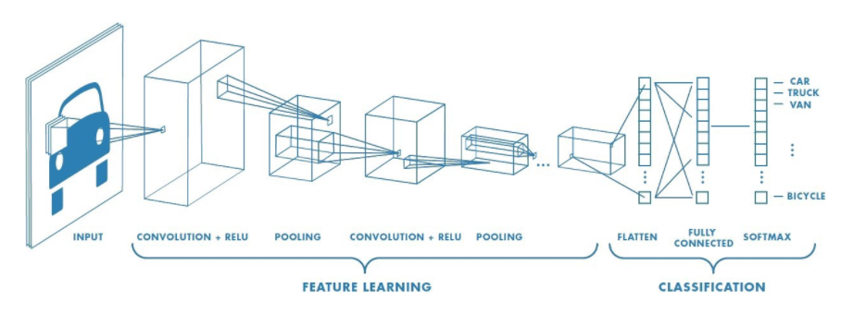
Neural Network
Convolutional neural networks refer to a sub-category of neural networks: they, therefore, have all the characteristics of neural networks.
However, CNN is specifically designed to process input images. Their architecture is then more specific: it is composed of two main blocks

Slide 43
The First Block
The first block makes the particularity of this type of neural network since it functions as a feature extractor. To do this, it performs template matching by applying convolution filtering operations. The first layer filters the image with several convolution kernels and returns “feature maps”, which are then normalized (with an activation function) and/or resized.
This process can be repeated several times: we filter the features maps obtained with new kernels, which gives us new features maps to normalize and resize, and we can filter again, and so on. Finally, the values of the last feature maps are concatenated into a vector. This vector defines the output of the first block and the input of the second.

Slide 44
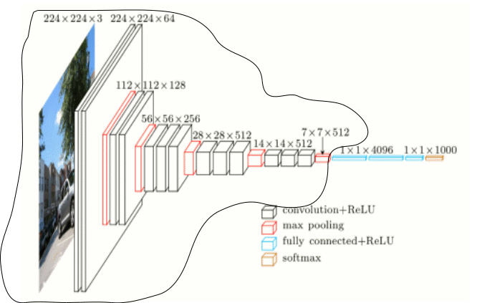
The first block

Slide 45
The second block
The second block is not characteristic of a CNN: it is in fact at the end of all the neural networks used for classification. The input vector values are transformed (with several linear combinations and activation functions) to return a new vector to the output.
This last vector contains as many elements as there are classes: element i represents the probability that the image belongs to class i.
Each element is therefore between 0 and 1, and the sum of all is worth 1. These probabilities are calculated by the last layer of this block (and therefore of the network), which uses a logistic function /sigmoid function(binary classification) or a softmax function (multi-class classification) as an activation function.
As with ordinary neural networks, the parameters of the layers are determined by gradient backpropagation: the cross-entropy is minimized during the training phase. But in the case of CNN, these parameters refer in particular to the image features.

Slide 46
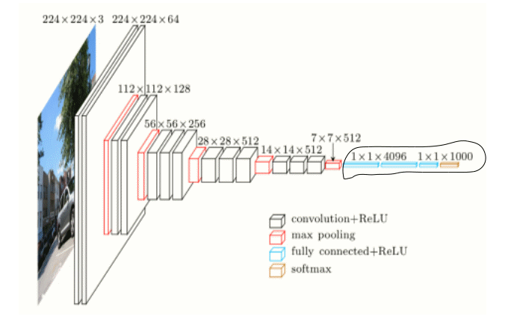
The second block

Slide 47
CNN
The different layers of a CNN
There are four types of layers for a convolutional neural network:
The convolutional layer,
The pooling layer,
The ReLU correction layer and
The fully-connected layer.

Slide 48
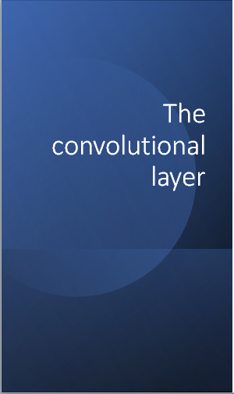
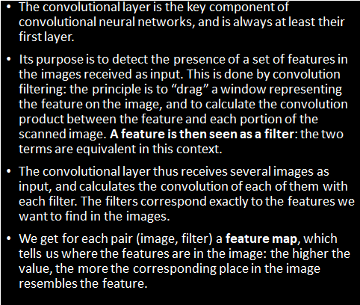

Slide 49
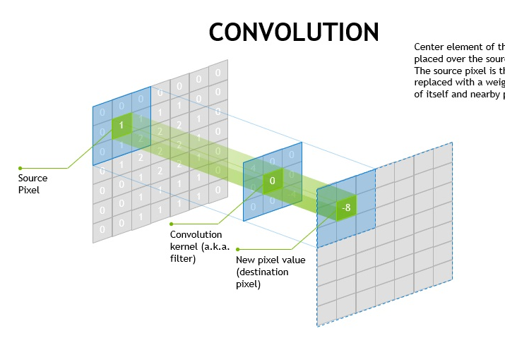

Slide 50
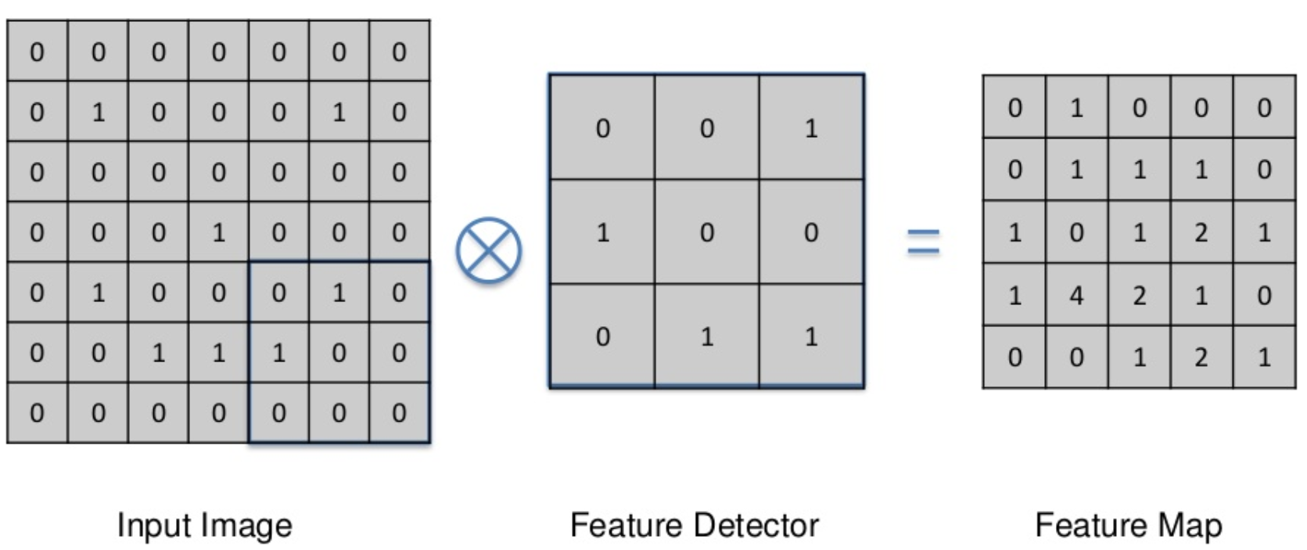
Convolution

Slide 51
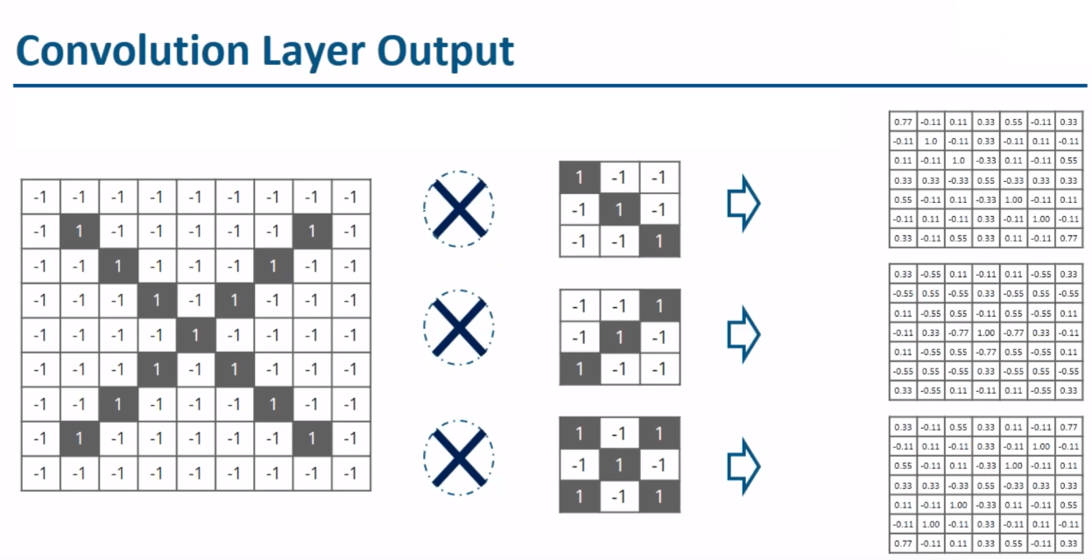
Feature Maps

Slide 52
Dimension of Feature Map
Dimension of Feature map:-
((n-f+2p/s)+1)*((n-f+2p/s)+1)* nc

Slide 53
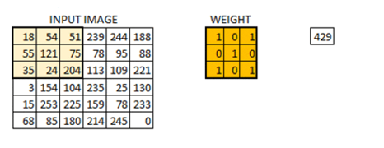
One More Example

Slide 54
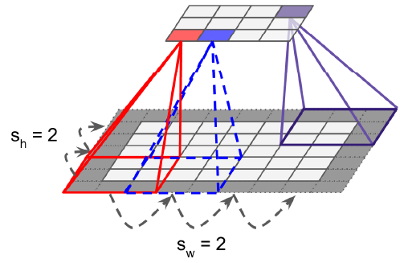
Stride/Padding
Stride:
Stride denotes how many steps we are moving in each steps in convolution.
By default it is one.
Padding:
Padding is a process of adding zeros to the input matrix symmetrically to maintain the dimension of output as in input

Slide 55
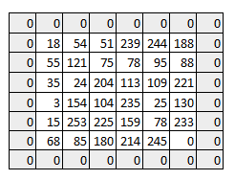
Padding
As you can see the size of image keeps on reducing as we increase the stride value. Padding the input image with zeros across it solves this problem for us.
We can also add more than one layer of zeros around the image in case of higher stride values.
We can see how the initial shape of the image is retained after we padded the image with a zero. This is known as same padding since the output image has the same size as the input.

Slide 56
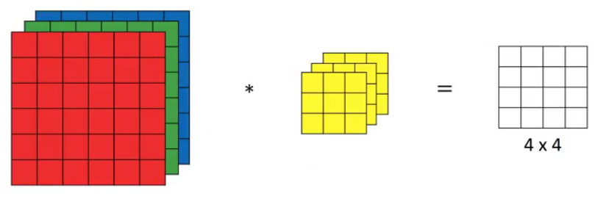
Convolution over the Volume

Slide 57


Slide 58








Slide 59

Neural Network

Slide 60

The output from the each filter is stacked together forming the depth dimension of the convolved image. Suppose we have an input image of size 32*32*3. And we apply 10 filters of size 5*5*3 with valid padding. The output would have the dimensions as 28*28*10.

Slide 61

How Convolution looks like in a real image.

Slide 62

ReLU Correction
ReLU (Rectified Linear Units) refers to the real non-linear function defined by ReLU(x)=max(0,x). Visually, it looks like the following:
The ReLU correction layer replaces all negative values received as inputs by zeros. It acts as an activation function

Slide 63


Slide 64
“What is Pooling?”
Quite Confusing

Slide 65

Some of you are Thinking about This Pool

Slide 66


Pooling
Sometimes when the images are too large, we would need to reduce the number of trainable parameters.
It is then desired to periodically introduce pooling layers between subsequent convolution layers.
Pooling is done for the sole purpose of reducing the spatial size of the image.
Pooling is done independently on each depth dimension, therefore the depth of the image remains unchanged.
The most common form of pooling layer generally applied is the max pooling.

Slide 67

Example
Here we have taken stride as 2, while pooling size also as 2. The max operation is applied to each depth dimension of the convolved output. As you can see, the 4*4 convolved output has become 2*2 after the max pooling operation.

Slide 68

Pooling for the first rectified feature map with window size = 2; stride = 2

Slide 69

As you can see I have taken convoluted image and have applied max pooling on it. The max pooled image still retains the information that it’s a car on a street. If you look carefully, the dimensions if the image have been halved. This helps to reduce the parameters to a great extent.
Similarly other forms of pooling can also be applied like average pooling or the L2 norm pooling.

Slide 70
The Output Layer
After multiple layers of convolution and padding, we would need the output in the form of a class.
The convolution and pooling layers would only be able to extract features and reduce the number of parameters from the original images.
However, to generate the final output we need to apply a fully connected layer to generate an output equal to the number of classes we need.
It becomes tough to reach that number with just the convolution layers. Convolution layers generate 3D activation maps while we just need the output as whether or not an image belongs to a particular class.
The output layer has a loss function like categorical cross-entropy, to compute the error in prediction.
Once the forward pass is complete the backpropagation begins to update the weight and biases for error and loss reduction.

Slide 71
The Output Layer
We pass an input image to the first convolutional layer. The convoluted output is obtained as an activation map. The filters applied in the convolution layer extract relevant features from the input image to pass further.
Each filter shall give a different feature to aid the correct class prediction. In case we need to retain the size of the image, we use same padding(zero padding), otherwise valid padding is used since it helps to reduce the number of features.
Pooling layers are then added to further reduce the number of parameters
Several convolution and pooling layers are added before the prediction is made. Convolutional layer help in extracting features. As we go deeper in the network more specific features are extracted as compared to a shallow network where the features extracted are more generic.
The output layer in a CNN as mentioned previously is a fully connected layer, where the input from the other layers is flattened and sent so as the transform the output into the number of classes as desired by the network.
The output is then generated through the output layer and is compared to the output layer for error generation. A loss function is defined in the fully connected output layer to compute the mean square loss. The gradient of error is then calculated.
The error is then backpropagated to update the filter(weights) and bias values.
One training cycle is completed in a single forward and backward pass.

Slide 72

The Output Layer
Putting it All Together

Slide 73

Fully Connected Layer-Flattening

Slide 74

Classification

Slide 75


Slide 76


Slide 77


Slide 78
Let’s See the Implementation

